Slide 1
Employee Data Analysis using Excel
STUDENT NAME: DEEPA B
REGISTER NO:312201092
NM ID: EB4A2FEF72D416C8EFB445606A9D8B99
DEPARTMENT: B.COM (ACCONUTING &FINANCE)
COLLEGE: D.R.B.C.C.C.HINDU.COLLEGE

Slide 2

PROJECT TITLE
Employee Performance Analysis using Excel

Slide 3

AGENDA
Problem Statement
Project Overview
End Users
Our Solution and Proposition
Dataset Description
Modelling Approach
Results and Discussion
Conclusion
3/21/2024 Annual Review

Slide 4

PROBLEM STATEMENT
Objective: To ensure fair and effective bonus, promotion, and training decisions.
Issue: Inconsistent performance metrics and ineffective monitoring lead to biased evaluations.
Impact: This undermines employee satisfaction and hampers organizational growth.

Slide 5

PROJECT OVERVIEW
The project aims to enhance employee performance evaluations for fair bonus allocation, promotions, and targeted training. We collect and analyze performance data using pivot tables to organize metrics by business unit and over time. Slicers and charts are employed to visualize trends and compare performance. A comprehensive dashboard integrates these elements for interactive reporting. The goal is to improve evaluation accuracy and support informed decision-making for organizational growth.

Slide 6
WHO ARE THE END USERS?
HR Managers: Utilize performance data to make decisions regarding bonuses, promotions, and training needs.
Team Leaders: Monitor performance to provide feedback and identify areas for employee development.
Executives: Analyze overall performance trends to guide strategic planning and organizational improvements.
Employees: Receive feedback on their performance and insights for personal development.
Training and Development Teams: Use performance data to create targeted training programs to address skill gaps.

Slide 7

OUR SOLUTION AND ITS VALUE PROPOSITION
Solution: Implement a comprehensive performance analysis system using Excel, including pivot tables, charts, and dashboards, to accurately track and visualize employee performance across various metrics.
Value Proposition:
Enhanced Accuracy: Provides precise and consistent performance evaluations, improving fairness in bonus allocation and promotion decisions.
Informed Decision-Making: Offers actionable insights through data visualization, supporting better management decisions and targeted training initiatives.
Increased Efficiency: Streamlines the analysis process with interactive dashboards and slicers, making performance data easily accessible and interpretable.
Organizational Growth: Helps identify high performers and areas for improvement, fostering employee development and aligning performance with organizational goals.

Slide 8
Dataset Description
Data Source:
Collected from Eudunet Foundation Dashboard, providing comprehensive employee performance information.
They are 26 features .
Key Variables:
Employee ID: Unique identifier for each employee.
Business Unit: Department or division where the employee works.
Performance Score: Numeric measure of employee performance.
Employee Type: Classification as full-time, part-time, or contract.
Gender: Employee’s gender.
Performance Level: Rating of performance as very high, high, medium, or low.
Year: Year associated with the performance data.

Slide 9
THE "WOW" IN OUR SOLUTION
Interactive Dashboard:
Comprehensive View: Integrates all performance data into a single, user-friendly interface for easy access and analysis.
Dynamic Visualization: Uses charts, graphs, and pivot tables to provide real-time insights and highlight key performance trends.
Customizable Filters: Employs slicers to enable users to drill down into specific data subsets, such as performance by department or employee type.
3/21/2024 Annual Review
9

Slide 10
MODELLING
Convert Data to Table:
Transform the dataset into an Excel table for easier management and updates.
Create Pivot Tables:
Summarize performance metrics by setting up pivot tables using the data table.
Generate Charts:
Visualize performance data with charts based on the pivot table.
Build Dashboard:
Assemble pivot tables, charts, and slicers into a cohesive, interactive dashboard.
Final Adjustments:
Refine the dashboard for clarity and ensure all components
are linked and functional.
10

Slide 11
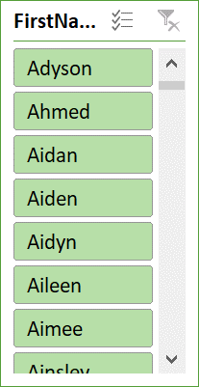
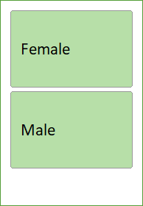
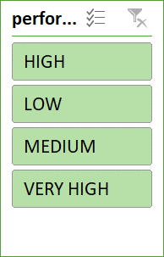
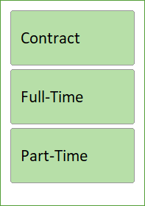
RESULTS
EMOLPYEE PERFORMANCE ANALYSIS
V
11

Slide 12
conclusion
Training and Motivation:
Employees with medium and low performance levels require targeted training and motivation to improve their performance.
Performance Evaluation:
The analysis provides valuable insights into individual performance, highlighting areas of weakness and identifying opportunities for growth.
Organizational Impact:
Effective performance analysis is crucial for evaluating and enhancing employee performance, addressing poor performance areas, and driving organizational growth.
Current Situation:
The organization is currently experiencing slower growth, emphasizing the need for improved performance management and employee development strategies.

